Slide 1
Taylor Perry
Implementation of Student RFID Cards at CSU

Slide 2
Statement of Purpose
I wanted to base my project on a problem that was of the time.
How to leave chapel faster with the same reliability.
I was interested in combining hardware and software
Excuse to learn Arduino/Raspberry pi

Slide 3
Research and Background
RFID is a sub-category of RADAR technology
Has mainly been used for logistics use
Different readers determine the read distance
Readers that can read up to 10 feet away can cost +$400
Not much more can be discovered about this technology but utilization can be improved.

Slide 4
Project languages, software, and Hardware
C++ was used both for Arudino code and code used to produce Student ID’s
Software used: Arduino IDE, Visual Studio Code, Excel
Hardware: • Arduino Uno •RC522 RFID Reader •Micro-card Reader •RTC 3231 module •Active buzzer •220 Resister •2K Resister •Red light • 12 male to male wires • 20 male to female wires •1 or more RFID tags • Breadboard • Micro-SD card

Slide 5
Project Requirements
A working computer that has a USB connection.
The software and hardware mentioned in Project software

Slide 6
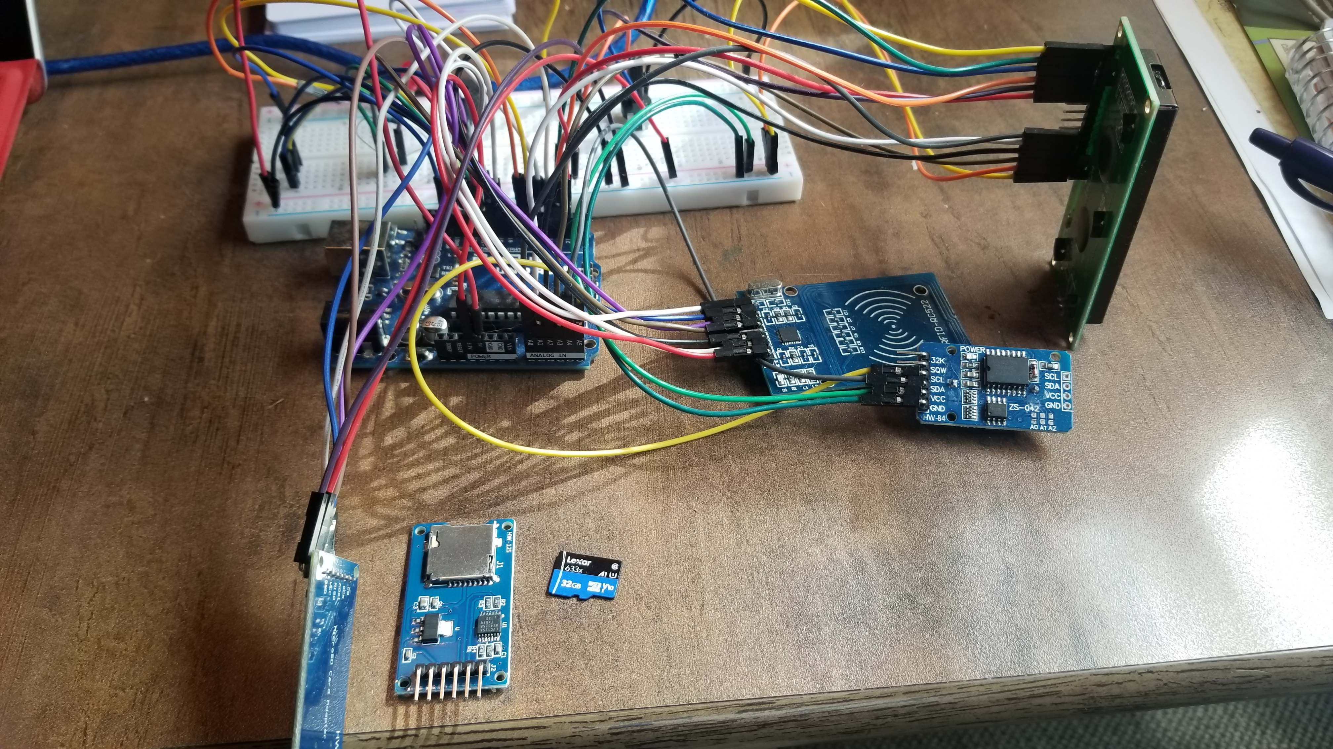
Project implementation
This is what my final projected looked like.
Arduino Uno
RFID Module
Micro-card Reader
RTC module
LCD screen

Slide 7
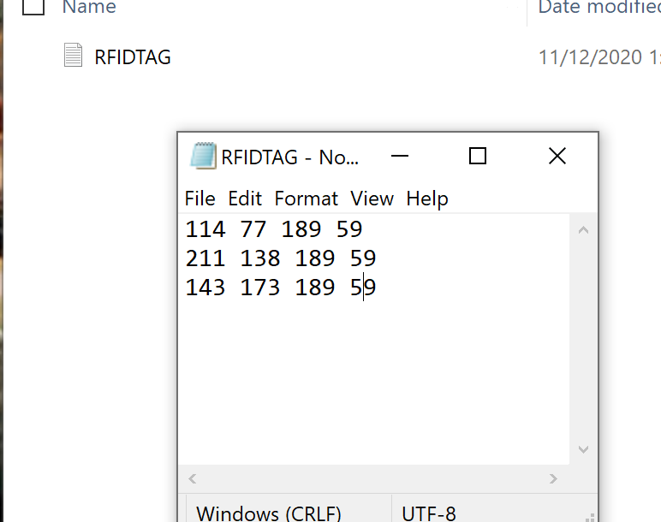
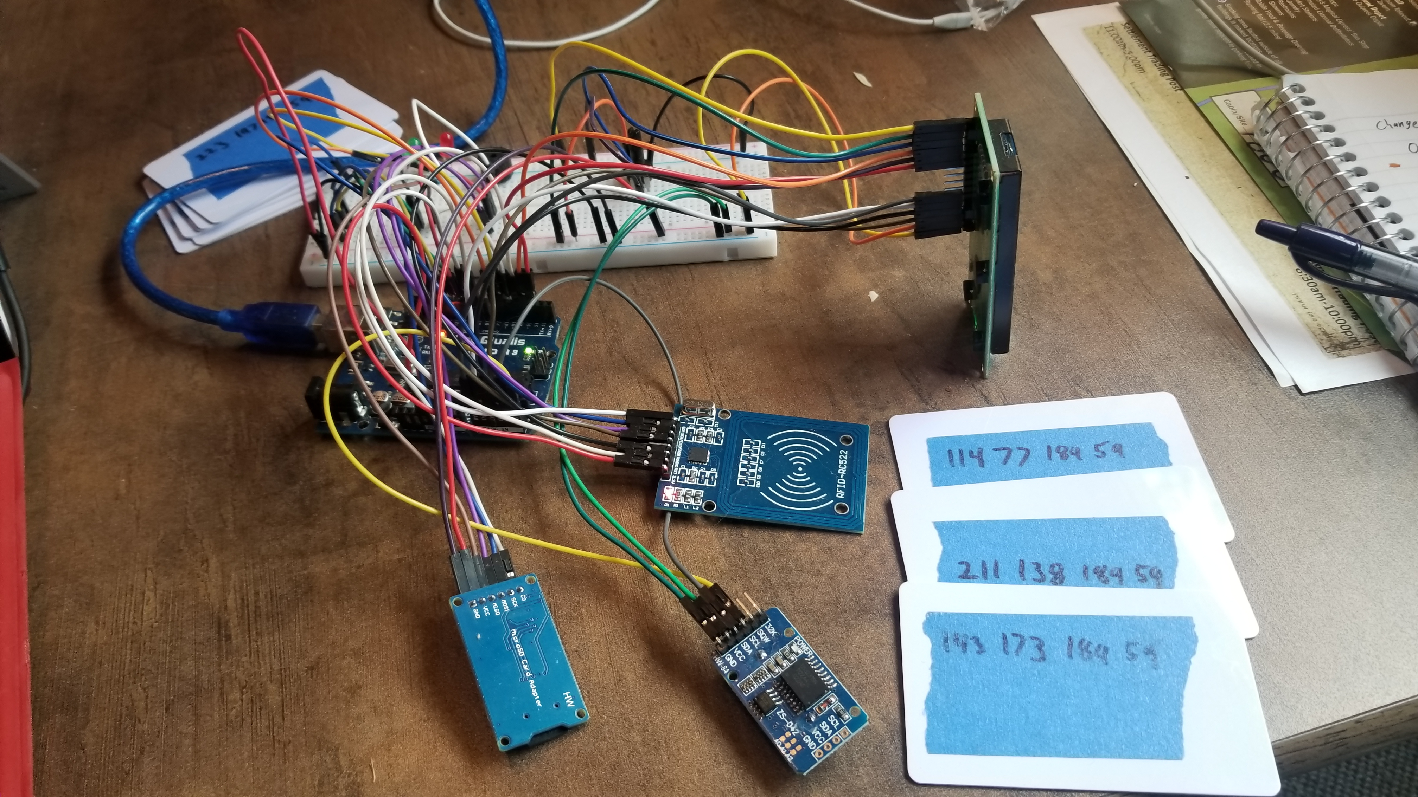
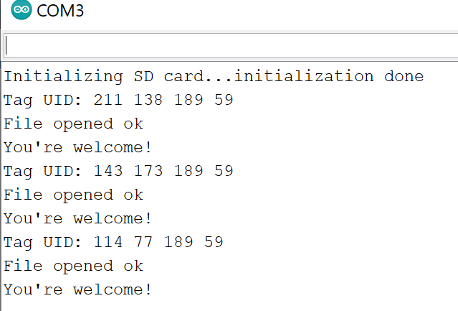
Implementation cont.
Fig.3
Fig.1
Fig.2

Slide 8
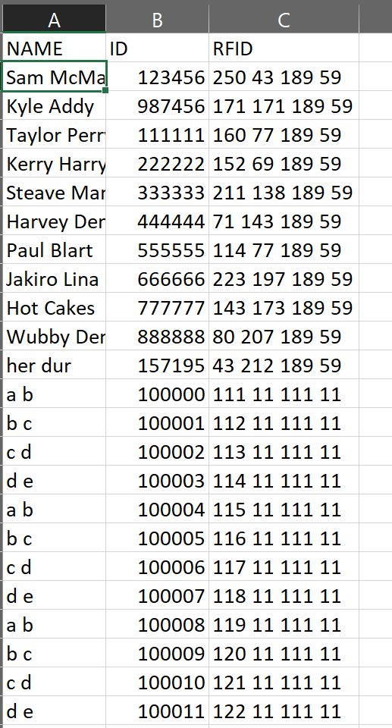
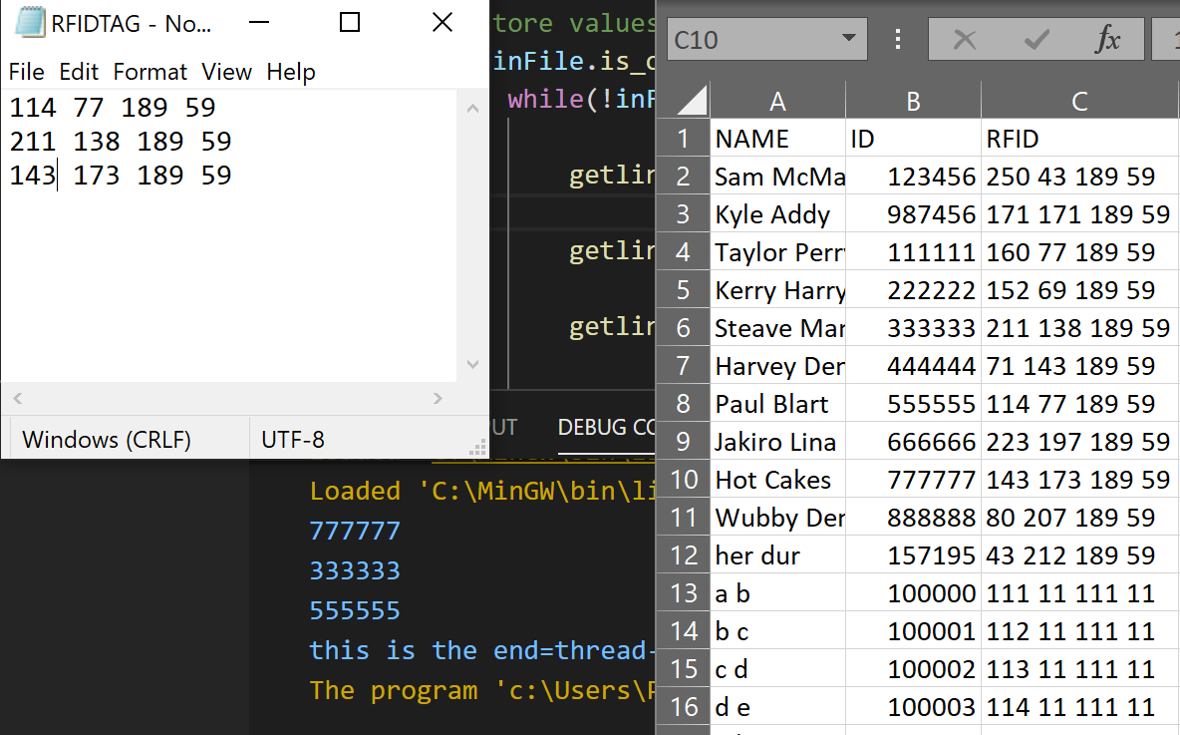
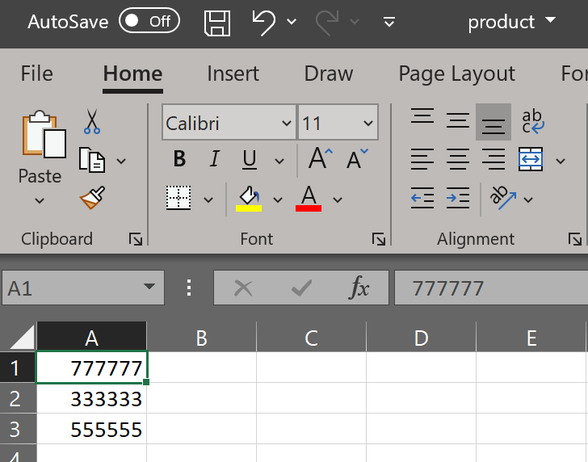


Implementation cont.
Fig.4
Fig.5
Fig.6

Slide 9
Test Plan and Results
Test | Expected Outcome | Actual Outcome
If Duplicate RFID cards were scanned what happens? | The card is not scanned unless they get in line again. | The identical cards cannot be scanned in a row, but if a student got back in line it would produce a duplicate Student ID result.
Will the Project run If not connected to a computer? | The Arduino saves the last ran program so it should run without a computer | The Arudino Uno can be plugged into a secondary power source and hitting reset will run the last saved program
When a RFID card is scanned quickly does it pick up | As long as the tag touches the reader the information will transefer | Since the RFID tag value is so small there is no problem wish a simple “tap” and go.

Slide 10
Challenges Overcome
Troubles with multiple “Slave devices”
This was solved by including in the Arduino code to include digitalWrite(CS_SD,HIGH/LOW);
Learning Arduino
Started with the basics of what I needed to know and then incorporated individual parts together.
Broken parts
Transporting my project i broke some wires and this made me realize that at the time I didn’t have a back up for some parts so I would have been in a bad place if I didn’t already have a replacement on hand.

Slide 11
Future Enhancements
Connect my Arduino to IOT
This could make it to where it compares the scanned RFID tags to a database and then automatically gives a list of Student ID’s
This would also open up to allowing certain majors have access to special rooms while also adding additional values to their RFID tag.
Create at more compact portable version.

Slide 12

The End

